Slide 1

Modelling of Cryptographic Accelerator using Simulink
By Chinmayi G S
Department of Electronics and Communication Engineering

Slide 2

INTRODUCTION
Cryptography is the science of securing information by converting readable data (plaintext) into an unreadable format (ciphertext) using encryption algorithms and cryptographic keys.
The encrypted data can only be converted back to its original form through decryption using the appropriate key, ensuring confidentiality and secure communication.
Elliptic Curve Cryptography (ECC) is a public-key cryptographic technique that provides high security with smaller key sizes, making it suitable for embedded systems and IoT devices.
This project focuses on modeling an ECC-based cryptographic accelerator to perform secure key generation, encryption, and decryption efficiently.

Slide 3
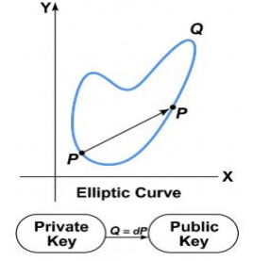
OBJECTIVES AND SCOPE
To design and model an Elliptic Curve Cryptography (ECC)-based cryptographic accelerator for secure data transmission.
To implement key generation, encryption, and decryption for ensuring data confidentiality and integrity.
To improve the efficiency, speed, and security of cryptographic operations for embedded applications.
To support secure communication in embedded systems, IoT devices, and wireless networks.
To provide a foundation for future FPGA/ASIC implementation and real-time cryptographic applications.

Slide 4
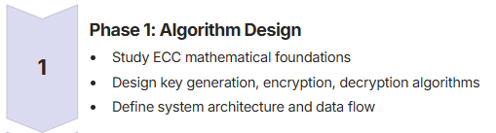
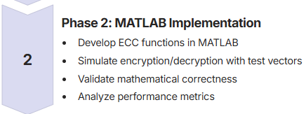
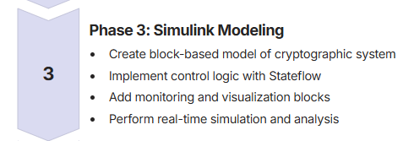
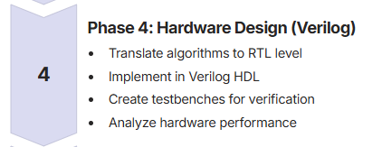
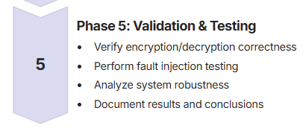
METHODOLOGY

Slide 5
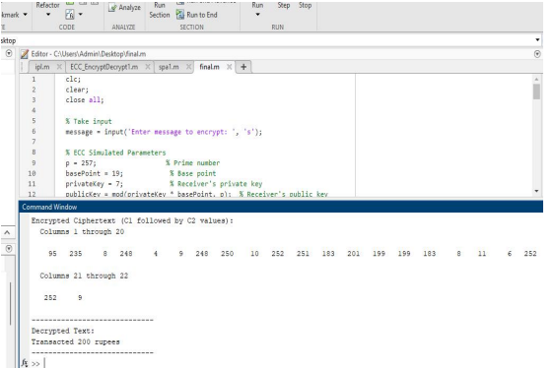
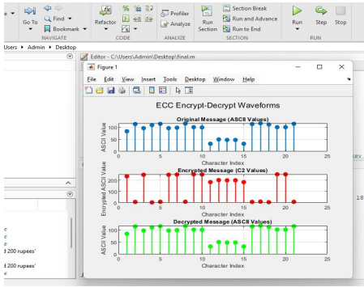
RESULTS

Slide 6
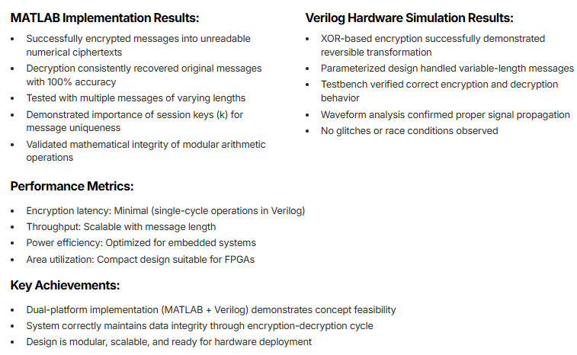
RESULTS

Slide 7
REFERENCES
[1] Kirit V. Patel, Mihir V. Shah, Pankaj P. Prajapati, Anil J. Kshatriya, "Design and Implementation of Effective Elliptic Curve Cryptography Accelerator using Hardware/Software Co-Design on Zynq Board," International Journal of Engineering Trends and Technology, vol. 70, no. 8, pp. 327-335, 2022.
[2] KASHIF, MUHAMMAD and ÇİÇEK, İHSAN (2021) "Field-programmable gate array (FPGA) hardware design and implementation of a new area efficient elliptic curve crypto-processor," Turkish Journal of Electrical Engineering and Computer Sciences, Vol. 29, No. 4, Article 17.
[3] Liu, Z., Seo, H., Großschädl, J., Kim, H. (2013). Efficient Implementation of NIST-Compliant Elliptic Curve Cryptography for Sensor Nodes. In: Information and Communications Security. ICICS 2013. Lecture Notes in Computer Science, vol 8233. Springer, Cham.
[4] Marco Indaco, Fabio Lauri, Andrea Miele, Pascal Trotta (2015). "An Efficient Many-Core Architecture for Elliptic Curve Cryptography Security Assessment," Cryptology ePrint Archive, Paper 2015/638.
[5] FPGA Acceleration of AES Algorithm for High-Performance Cryptographic Applications
[6] Kadu, R.K., Adane, D.S. (2020). Hardware Implementation of Elliptic Curve Cryptosystem Using Optimized Scalar Multiplication. In: Smart Trends in Computing and Communications. Smart Innovation, Systems and Technologies, vol 165. Springer, Singapore.
[7] Nilima D. Parmar, Poonam Kadam. High Speed Architecture Implementation of AES using FPGA. CAE Proceedings on International Conference on Communication Technology. ICCT2015, 5 (September 2015), 31-

